Slide 1
Algorithms and Data Structures
      Dr Mehmet Bülent Özcan,
      (Module Leader/Lecturer/Tutor)
        Room: Cantor 9418
        Phone: extn 6900
        Email: m.b.ozcan@shu.ac.uk

Slide 2
Learning Objectives
To understand the notion of data structure
To investigate seven fundamental data structures, namely arrays, sparse matrices, stacks, queues, singly linked lists, trees and graphs

Slide 3
Contents of the Lecture
Basic Terminology
What is covered in this module?
Arrays
Sparse Matrices
Linked Lists
Stacks
Queues
Binary trees
Graphs

Slide 4
Basic Terminology
Data are simply values or sets of values.
A data item refers to a single unit of values.
Data may be organised in many ways; the logical or mathematical model of a particular organisation of data is called a data structure. The choice of a particular data model depends on two considerations:
  it must be rich enough in structure to mirror the actual relationships of the data in the real world;
  the structure should be simple enough that one can effectively process the data when necessary.

Slide 5
What is covered in this module?
The remainder of this module will be devoted to various data structures and operations associated with them. The following data structures will be examined:
  Arrays (single dimensional, two dimensional)
  Stacks
  Queues
  Singly linked lists
  Trees
  Graphs
  Hash tables
In this lecture note, a brief overview of the first six data structures will be provided.

Slide 6
Arrays
The simplest data structure is a linear (or one-dimensional) array. By a linear array, we mean a list of finite number of n of similar data elements referenced respectively by a set of n consecutive numbers, usually 1, 2, 3, …, n. If we choose the name A for the array, then the elements of A are denoted by subscript notation
a₁, a₂, a₃, …. A_{n}
or by the parenthesis notation
A(1), A(2), A(3), ….A(n)
or by the bracket notation
A[1], A[2], A[3], ….A[n]

Slide 7
Arrays (2)
Regardless of notation, the number K in A(K) is called a subscript (or index) and A(K) is called a subscripted variable.
Linear arrays are called one-dimensional arrays because each element in such an array is referenced by one subscript (or index).
Example: A linear array STUDENT consists of the names of six students as shown below. Here STUDENT(1) denotes John Brown, STUDENT(2) denotes Sandra Gold, and so on.
STUDENT
1 | John Brown
2 | Sandra Gold
3 | Tom Jones
4 | June Kelly
5 | Mary Reed
6 | Alan Smith

Slide 8
Arrays (3)
A two-dimensional array (or a matrix) is a collection of similar data elements where each element is referenced by two subscripts. (Such arrays are called matrices in mathematics and tables in business applications). Multi-dimensional arrays are defined analogously.
SALES(1,1)=2872, SALES(1,2)=805, SALES(1,3)=3211, …, SALES(28,4)=982
The size of this array is denoted by 28X4 since it contains 28 rows (the horizontal lines of numbers) and 4 columns (the vertical lines of numbers).
Store\Department | 1 | 2 | 3 | 4
1 | 2872 | 805 | 3211 | 1560
2 | 2196 | 1223 | 2525 | 1744
3 | 3257 | 1017 | 3686 | 1951
… | … | … | … | …
28 | 2618 | 931 | 2333 | 982

Slide 9
Sparse Matrices
A matrix is a mathematical object which arises in many physical problems. As computer scientists, we are interested in studying ways to represent matrices so that the operations to be performed on them can be carried out efficiently.
A general matrix consists of m rows and n columns of numbers as shown below. In general, we write m X n to designate a matrix with m rows and n columns.
 | column 1 | column 2
row 1 | -27 | 3
row 2 | 5 | -24
row 3 | 3.4 | 78
row 4 | -64 | -0.3
row 5 | 1 | 6
row 6 | 9 | 34
row 7 | 2.7 | 7.8
row 8 | 0 | 2
row 9 | -1 | 0

Slide 10
Sparse Matrices (2)
It is natural to store a matrix in a two-dimensional array.
Now, consider the following matrix in which there are many zero entries. Such a matrix is called sparse.
There is no precise definition of when a matrix is sparse and when it is not, but it is a concept which we can all recognize intuitively.
 | column 1 | column 2
row 1 | -27 | 0
row 2 | 0 | 0
row 3 | 3.4 | 0
row 4 | 0 | -0.3
row 5 | 0 | 0
row 6 | 9 | 0
row 7 | 0 | 7.8
row 8 | 0 | 2
row 9 | -1 | 0

Slide 11
Sparse Matrices (3)
A sparse matrix requires us to consider an alternate form of representation.
This is because in practice many of the matrices we want to deal with are large, e.g., 10,000 X 10,000, but at the same time they are sparse: say only 1000 out of one hundred million possible elements are nonzero. It is costly to store a full 10,000 X 10,000 matrix in the memory at once. Therefore, we need to consider alternative representation for sparse matrices.
The alternative representation will explicitly store only the nonzero elements. Each element of a matrix is uniquely characterized by its row and column position, say i,j. We might then store a matrix as a list of 3-tuples of the form
(i,j,value)

Slide 12
Sparse Matrices (4)
In addition, it might be helpful to organize this list of 3-tuples in some way, perhaps placing them so that the row numbers are increasing. We can go one step farther and require that all the 3-tuples of any row be stored so that the columns are increasing. Thus, we might store the second matrix of shown in the previous slide in the array A(0:t,1:3) where t = 7 is the number of nonzero terms.
 | column 1 | column 2
row 1 | -27 | 0
row 2 | 0 | 0
row 3 | 3.4 | 0
row 4 | 0 | -0.3
row 5 | 0 | 0
row 6 | 9 | 0
row 7 | 0 | 7.8
row 8 | 0 | 2
row 9 | -1 | 0
 | 1) | 2) | 3)
A(0, | 9 | 2 | 7
A(1, | 1 | 1 | -27
A(2, | 3 | 1 | 3.4
A(3, | 4 | 2 | -0.3
A(4, | 6 | 1 | 9
A(5, | 7 | 2 | 7.8
A(6, | 8 | 2 | 2
A(7, | 9 | 1 | -1

Slide 13
Sparse Matrices (5)
Two kinds of sparse matrix often arise in numerical calculations. These are triangular and tridiagonal matrices respectively.
 | column 1 | column 2 | column 3 | column 4 | column 5
row 1 | -27
row 2 | 7 | -4
row 3 | 3.4 | 34 | 56
row 4 | 76 | -0.3 | -87 | 3
row 5 | -2 | -6 | -8 | 21 | 9
 | column 1 | column 2 | column 3 | column 4 | column 5 | column 6 | column 7
row 1 | 5 | -3
row 2 | 1 | 4 | 3
row 3 |  | 9 | -3 | 6
row 4 |  |  | 2 | 4 | -7
row 5 |  |  |  | 3 | -1 | 4
 |  |  |  |  | 6 | -5 | 8
row 6 |  |  |  |  |  | 3 | -1

Slide 14
Singly Linked Lists
Suppose a brokerage term maintains a file where each record contains a customer's name and his or her salesperson, and suppose the file contains the appearing as below. Clearly the file could be stored in the computer by such a table, i.e., by two columns of nine names. However, this may not be the most useful, as the following discussion shows.
Table 1
 | Customer | Salesperson
1 | Adams | Smith
2 | Brown | Ray
3 | Clark | Jones
4 | Drew | Ray
5 | Evans | Smith
6 | Farmer | Jones
7 | Geller | Ray
8 | Hill | Smith
9 | Infeld | Ray

Slide 15
Singly Linked Lists (2)
This representation is not space-efficient since Salesperson details are repeated.
Consider an alternative arrangement.
 | Customer | Pointer
1 | Adams | 3
2 | Brown | 2
3 | Clark | 1
4 | Drew | 2
5 | Evans | 3
6 | Farmer | 1
7 | Geller | 2
8 | Hill | 3
9 | Infeld | 2
 | Salesperson
1 | Jones
2 | Ray
3 | Smith
Even though the above data structures avoid space inefficiency of the previous data structure, it introduces their own issues.

Slide 16
Singly Linked Lists (3)
One way to simplify such as search is to have the arrows in the previous figure point the other way; each salesperson would now have a set of pointers giving the positions of his or her customers as shown below:
 | Salesperson | Pointer
1 | Jones | 3, 6
2 | Ray | 2, 4, 7, 9
3 | Smith | 1, 5, 8

Slide 17
Singly Linked Lists (3)
Another popular way to store the type of data in Table 1 is shown below:
 | Customer | Link
1 | Adams | 5
2 | Brown | 4
3 | Clark | 6
4 | Drew | 7
5 | Evans | 8
6 | Farmer | 0
7 | Geller | 9
8 | Hill | 0
9 | Infeld | 0
 | Salesperson | Pointer
1 | Jones | 3
2 | Ray | 2
3 | Smith | 1

Slide 18
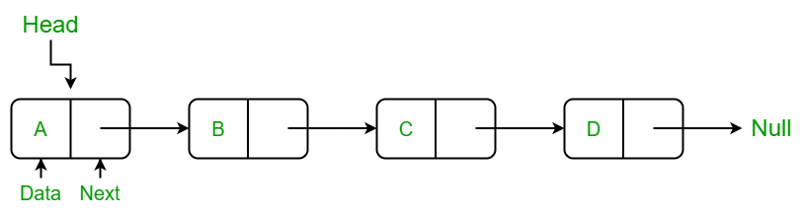
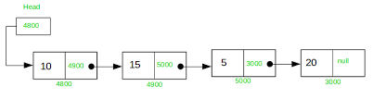
Representing Linked Lists in Memory

Slide 19
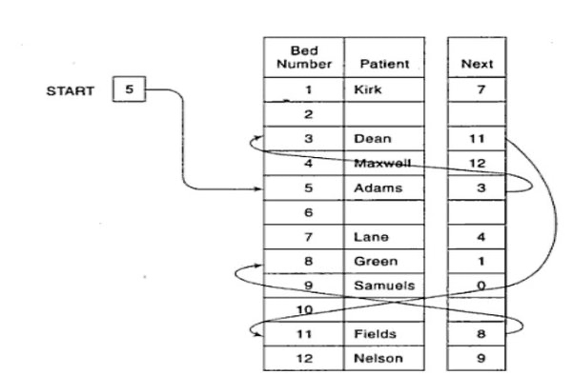
Representing Linked Lists in Memory (2)

Slide 20
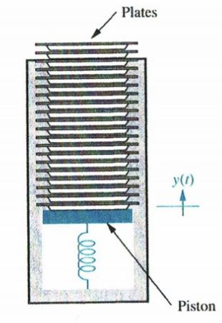
Stacks
A stack, also called a last-in first-out (LIFO) system, is a linear list in which insertions and deletions can take place only at one end, called the top. This structure is similar in its operation to a stack of dishes on a spring system, as shown below. Note that new dishes are inserted only at the top of the stack and dishes can be deleted only from the top of the stack.

Slide 21
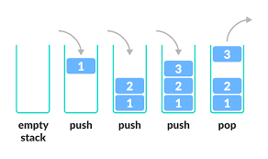
Stacks (2)

Slide 22
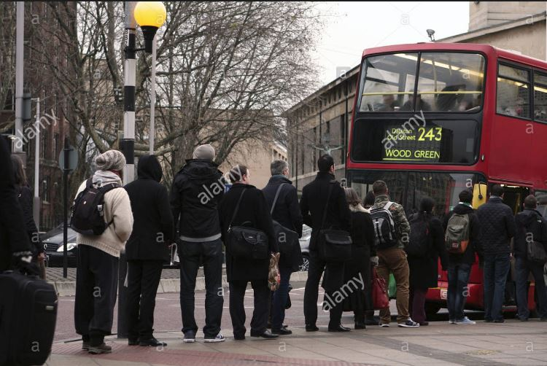
Queues
A queue, also called a first-in first-out (FIFO) system, is a linear list in which deletions can take place only at one end of the list, the "front" of the list, and insertions can take place only at the other end of the list, the "rear" of the list. This structure operates in much the same way as a line of people waiting at a bus stop.

Slide 23
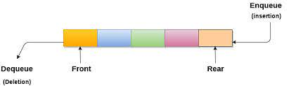
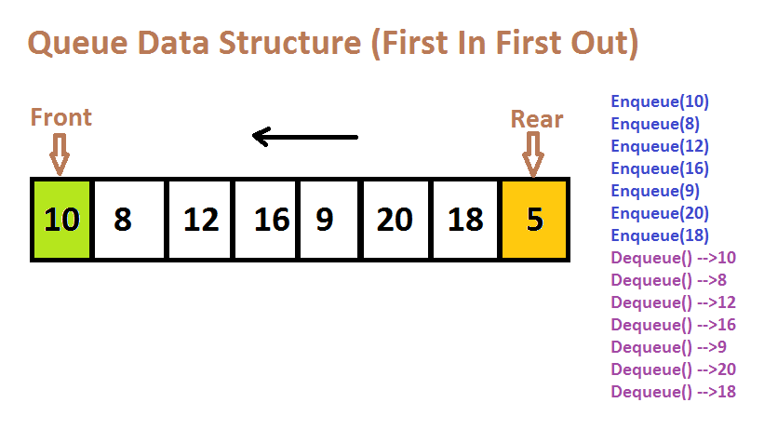
Queues (2)

Slide 24
Binary Trees
A binary tree T is defined as a finite set of elements, called nodes, such that:
  T is empty (called the null tree or empty tree), or
  T contains a distinguished node R, called the root of T, and the remaining nodes of T form an ordered pair of disjoint binary trees T₁ and T₂.
If T does contain a root R, then the two trees T₁ and T₂ are called, respectively, the left and right subtrees of R.
If T₁ is nonempty, then its root is called the left successor of R; similarly, if T₂ is nonempty, then its root is called the right successor of R.
The above definition of the binary tree T is recursive since T is defined in terms of the binary subtrees T₁ and T₂.

Slide 25
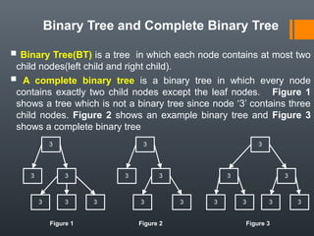
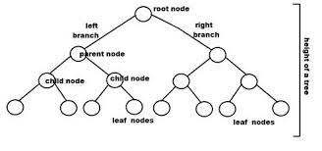
Binary Trees (2)
Every node of N of T contains a left and a right subtree. If N is a terminal node.
If N is a terminal node, then both its left and right trees are empty.

Slide 26
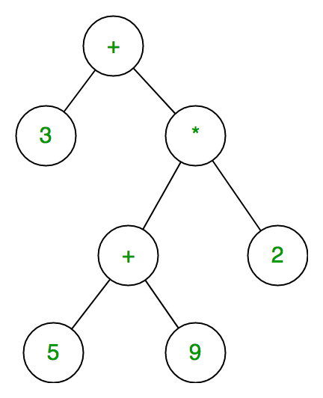
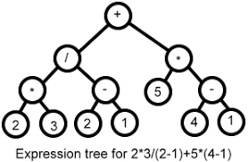
Binary Trees (3)

Slide 27

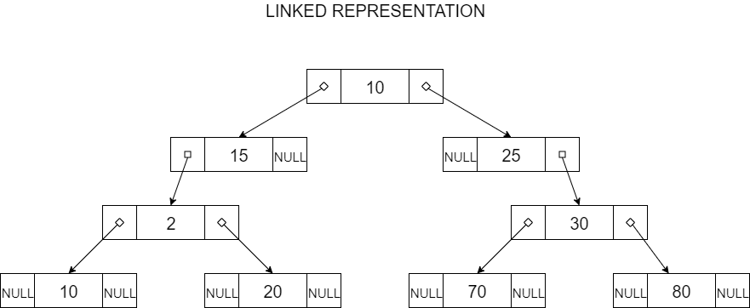
Representing Binary Trees in Memory

Slide 28
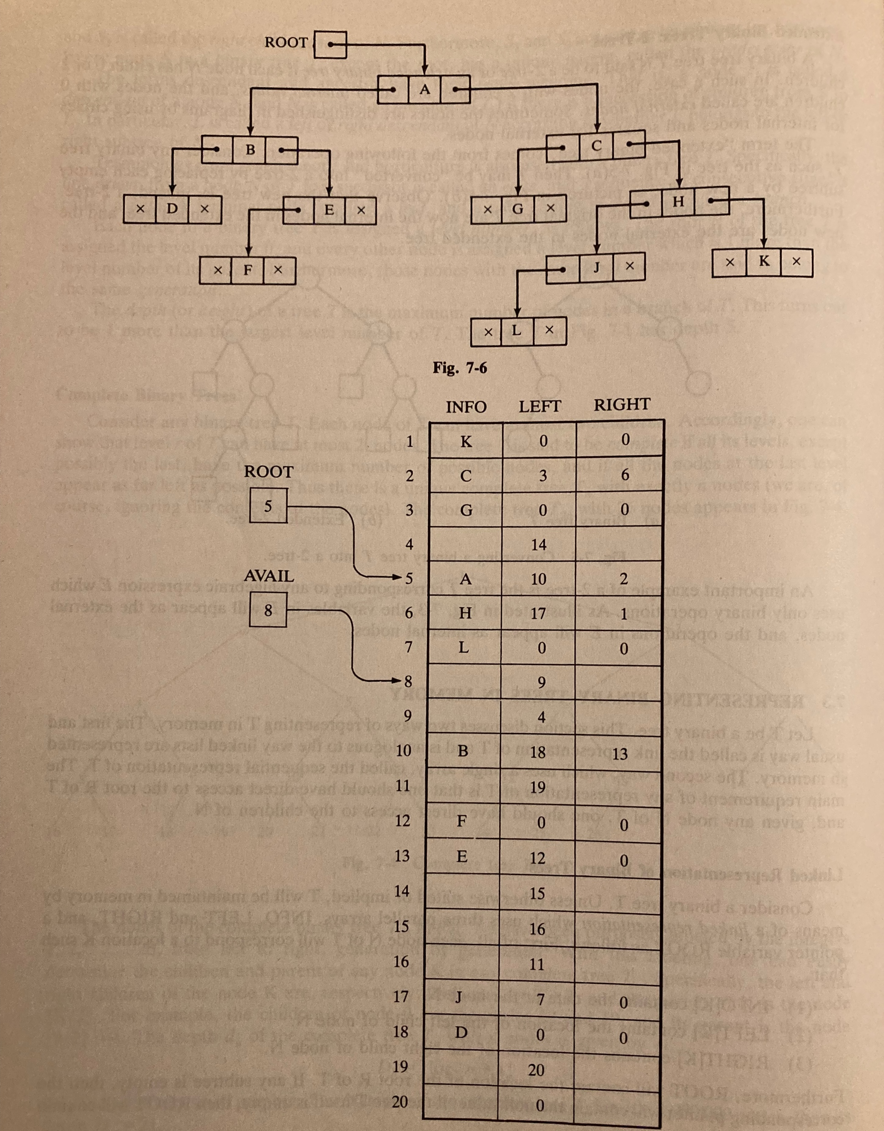
Representing Binary Trees in Memory (2)

Slide 29
Graphs
A graph G consists of two things:
  A set of V of elements called nodes (or points or vertices)
  A set of edges such that each edge e in E is identified with a unique (unordered) pair [u, v] of nodes in V, denoted by e = [u, v]
Proposition: A graph G is connected if and only if there is a simple path between any two nodes in G.
A graph G is said to be complete if every node in u in G is adjacent to every node v in G.

Slide 30
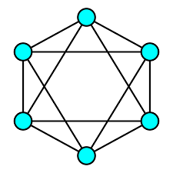
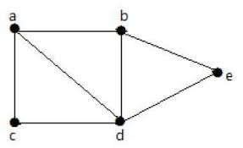
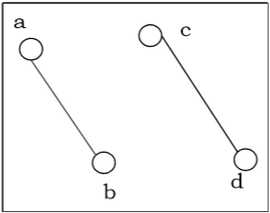
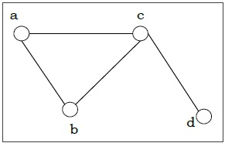
Connected Graphs

Slide 31
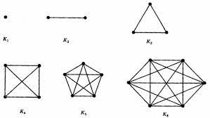
Complete Graphs

Slide 32
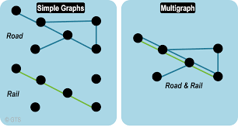
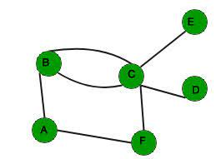
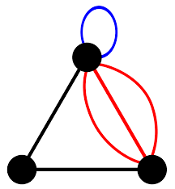
MultiGraph
The definition of a graph may be generalised by permitting the following:
  Multiple edges: Distinct edges e and e¹ are called multiple edges if they connect the same endpoints, that is, if e = [u, v] and e¹ = [u, v]
  Loops: An edge e is called a loop if it has identical endpoints., that is, if e = [u, u]
Such a generalisation is called a multigraph. In other words, the definition of a graph usually does not allow either multiple edges or loops.

Slide 33
Directed Graphs
A directed graph G, also called a digraph or graph, is the same as a multigraph except that each e in G is assigned a direction, or in other words, each edge e is identified with an ordered pair (u, v) of nodes in G rather than an unordered pair [u, v].
Suppose G is a directed graph with a directed edge e = (u, v). Then e is called an arc. Moreover, the following terminology is used:
  e begins at u and ends at v.
  u is the origin or initial point of e, and v is the destination or terminal point of e.
  u is the predecessor of v, and v is a successor or neighbour of u.
  u is adjacent to v, and v is adjacent to u.

Slide 34
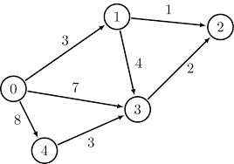
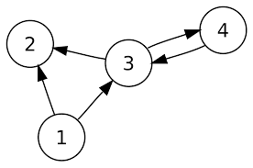
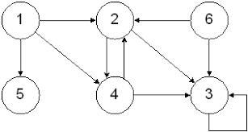
Directed Graphs (2)

Slide 35
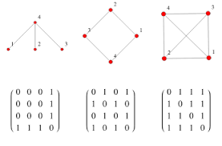
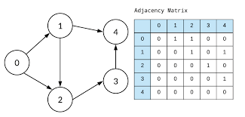
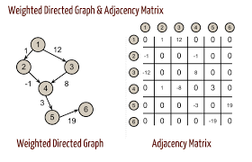
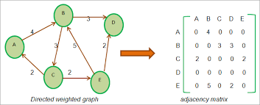
Representing Graphs in Memory- Adjacency Matrix

Slide 36
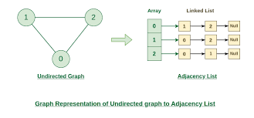
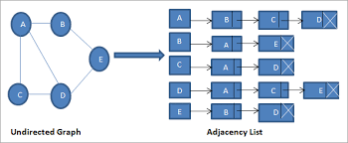
Representing Graphs in Memory- Adjacency Lists

Slide 37
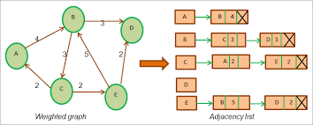
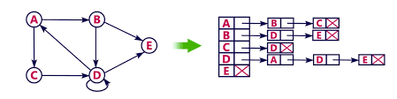
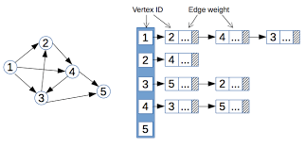
Representing Graphs in Memory- Adjacency Lists (2)

